Slide 1
DEAC Meeting Agenda: 12.4.14
1. AchieveNJ ( http://www.nj.gov/education/AchieveNJ/ )
2. PARCC Resources
3. Professional Learning
4. ScIP Check-In

Slide 2
AchieveNJ Update
SGPs to be released in January 2015
Will count 30% for Math/ELA teachers grades 4-8 toward 2013-14 final evaluation
Principals, Assistant Principals to receive median SGP
Adoption of Updates to Evaluation Regulations
Remove the December 1 deadline for completion of at least one co-observation to give districts more flexibility with implementation (note: two co-observations are still required at some point in the school year).
Amend written requirements of the observation report so districts can use electronic versions to save time.
Clarify that a teacher present for less than 40 percent of the total school days in an academic year must receive at least two observations to earn a teacher practice score.

Slide 3
PARCC Resources
PARCC Student Participation (10.30.14 letter from Acting Commissioner Hespe)
A Walk in the PARCC (from Director of Technology in WMRHSD, Erica Hartmann)
Transitioning Grade Requirements (from Dr. Bari Erlichson, Assistant Commissioner of Assessment, Data Analysis, PARCC, for NJDOE)
NJECC PARCC Meeting Minutes (from a meeting are at MSU)
NJECC PARCC PowerPoint (from Bergen County Curriculum Roundtable)
PARCC Lessons Learned

Slide 4
PARCC Student Participation Update 10.30.14
In February, 2014, the State Board passed a resolution confirming that district boards of education are obligated to implement the Core Curriculum Content Standards and to “ensure students meet the expectations and proficiency standards as measured by current and future State and local assessments.”
In accordance with the above, State law and regulations require all students to take State assessments (PARCC).
For the 2014-2015 school year, the PARCC assessment will replace the prior statewide assessments - the NJASK in grades 3-8 and HSPA in high school; as such, all students shall take the PARCC assessment as scheduled.
Since the PARCC assessment is part of the State required educational program, schools are not required to provide an alternative educational program for students who do not participate in the statewide assessment.

Slide 5
“A Walk in the PARCC”

Slide 6
Current Graduation Requirements
For the class of 2015:
English Language Arts | Mathematics
HSPA Score >=200 or | HSPA Score >=200 or
Passing AHSA performance tasks or | Passing AHSA performance tasks or
Meet the Criteria of the NJDOE Portfolio Appeal | Meet the Criteria of the NJDOE Portfolio Appeal

Slide 7
Transitioning Graduation Requirements
Classes of 2016, 2017, and 2018, meet ONE of the following:

Slide 8
Accessibility Accommodations for PARCC
Available for all students, not just special education students
Blank paper
Spell checker
Writing tools
Highlight tools
Headphones
State can decide on Text to Speech for Math availability

Slide 9
NJECC Presents: Assessment Practices & Shifts
“What do you mean I have to
change my assessments?”
SHIFT HAPPENS.
Notes:
Barry

Slide 10
Assessment Practices & Shifts
The best way to prepare students for the future is to focus on the present in a way that enables students to deal with problems that have more than one correct answer. The problems that matter most cannot be resolved by formula, algorithm, or rule. They require the exercise of that most exquisite human capacity that we call judgment. To cultivate this quality, the curriculum needs to consist of problems that permit judgment. Such problems require deliberation and yield multiple possible resolutions. Problems of a substantial magnitude usually need to be considered from various angles and can only be temporarily resolved. (E. Eisner, 2003)
Principles of Performance-Based Assessment
Novel, real-world context
Development of habits integrating key concepts and skills
No absolute answers: Multiple approaches
Production of extended responses
Notes:
Brad

Slide 11
Shift 1: Get rid of all T/F, fill in blank, and singular multiple choice questions.

Slide 12
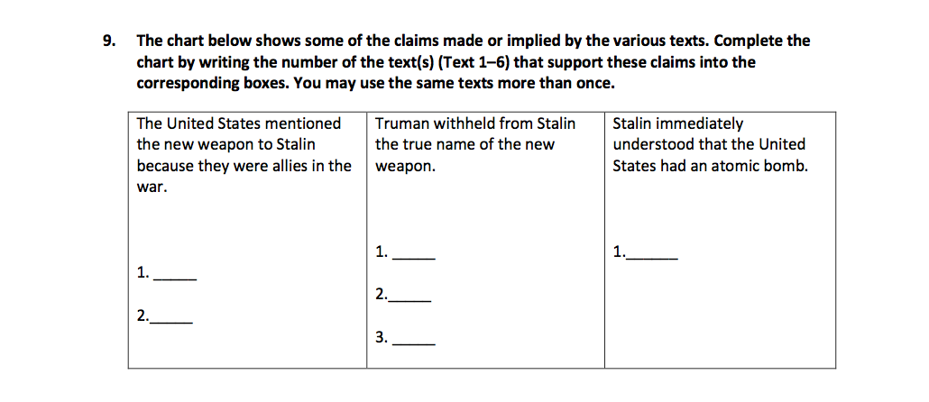
Shift 2: Two or more pieces of text to read to get evidence

Slide 13
Shift 3: It is not how you feel. It is what you can support. (Claim-Evidence)

Slide 14
Other shifts to consider:
Read items 30-60 years old
Get practice for students to read and answer online. (i.e. Google Docs)
Do more with less. (Work on skills of persistence, grit)
Have teachers show standards linked to assessments
Math: Shift to more than one answer...and it is more than formulas, working with graphics and focus on process, rigor, and complexity!

Slide 15
PARCC Lessons Learned
Responses from the student surveys administered at the end of the field test begin on page 8. Highlights include:
94% of students either finished the CBT ELA field test very early or on time and 87% did so for mathematics (p. 9).
Approximately 90% of the students in the PARCC CBT understood the directions read by test administrators (p. 10).
Students found the mathematics assessment more challenging than the ELA assessments overall regardless of whether the student took the field test via computer or paper (p. 11).
Approximately 90% of students who participated in the ELA CBT and 65% of students who participated in the mathematics CBT reported that it was easy to type their answers (p. 15).
Beginning in January 2015, NJDOE will host regional training sessions for test and tech coordinators to review administration manuals. A memo will be released as soon as dates and locations have been finalized.

Slide 16
Professional Development
PD Feedback from staff on PD Days 10.31 and 11.4.14
90% Thought the PD Days were Helpful or Really Helpful
District Goal:
Department/Grade Level Based (Differentiated)
DOK 1-2-3
Focus on ONE Culminating Assessment Per Unit
Link Questions to Standards
Hand in Prior to Administering Unit Assessment
Most Importantly … Conversations

Slide 17
Professional Development
2014-15 State Mandated Training (See Excel Spreadsheet)
Online: GCN (Global Compliance Network)
Staff has until April 1, 2014 to complete
Highlighted with different colors
District, Building, Individual Levels
Completed at faculty meetings, PD days, grade level/department meetings, etc.
Not Highlighted

Slide 18
ScIP Check-In
What is going on in your buildings?
Share any experiences pertaining to:
Professional Development
Mentoring
Observations
Other
How do you share DEAC information with your staff/colleagues?

